Slide 1


Slide 2
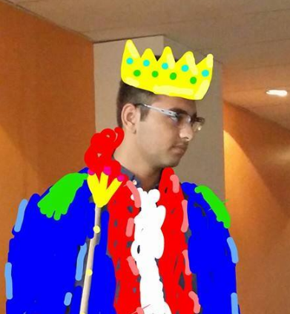
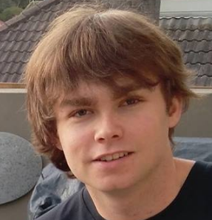
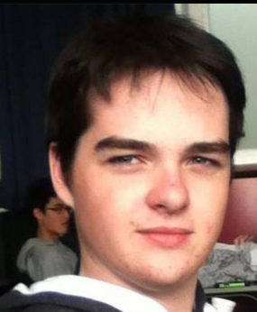
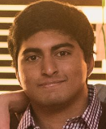
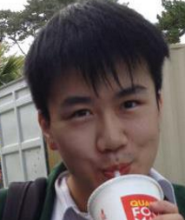
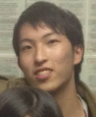
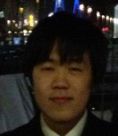

THE TEAM.
AMMAR
THE LEADER LINE
JACK
CAMPBELL
ADI
JUN
NATHAN
JUNO
KEVIN

Slide 3

Domain Model

Slide 4
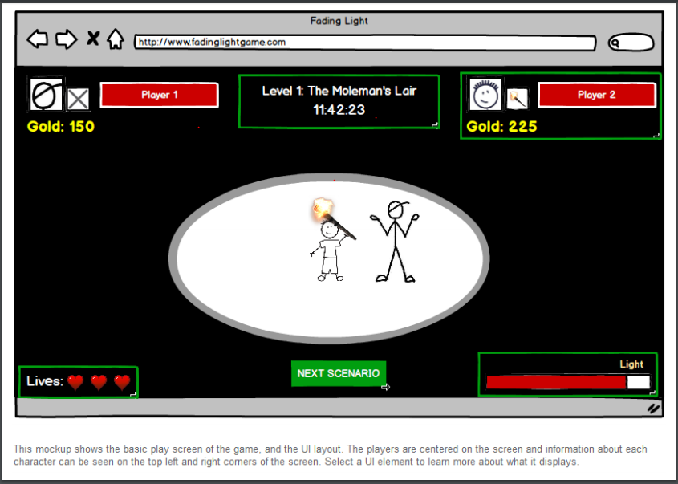
Lo-fi Prototype

Slide 5
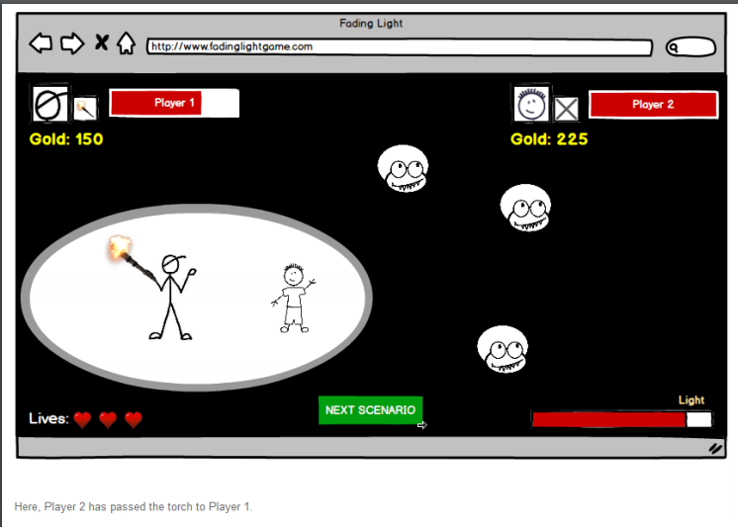
Lo-fi Prototype

Slide 6
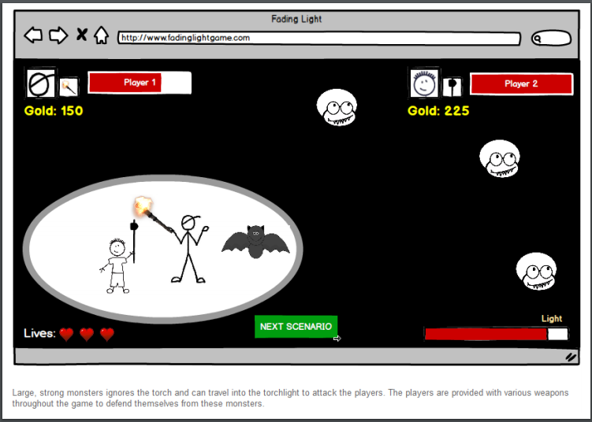
Lo-fi Prototype

Slide 7
Next Week
To Do:
Independent Level Design
Prototype
Coding and Research
Juno
Kevin

